Slide 1
Lax
Driver Interfaces for Approximate Sensor Device Access
Phillip Stanley-Marbell, Martin Rinard
Presented by: Jaxon Brown, John Morin, and Tim Dwyer

Slide 2
Answers To What We Are Looking For
•Type of approximation? Combination of hardware/software
•Approximation strategy? Voltage scaling
•How is it done? Device driver abstraction and associated hardware support
•What is being approximated? Sensor signal
•How to determine what to approximate? User defined
•How much approximation is acceptable? User defined
•What applications are being targeted? Embedded Sensors
Notes:
Approximation itself is implemented in hardware, but the user interface is in software
Voltage regulator controls the supply voltage provided to the sensor
User defined tolerances given to the driver -> driver controls voltage regulator
Sensor data is being approximated by error introduced in undervolting

Slide 3
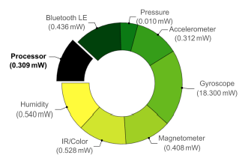
Why sensors?
Power consuming
Good candidates for approximation: (stateless, transactional, analog)
Sensors usually improved by manufacturer through circuit and device level advancements
Proposed solution (software driver implementation for voltage scaling) allows user end optimizations through…. Approximation!
Notes:
Power consuming:
in state of the art sensors...power used in accessing sensor may be greater than or equal to the computational elements
Graph shows relative power dissipation while active… all but one sensor use more power than the processor
Why candidates:
First, sensors are typically stateless, so that errors do not propagate to affect the next sample.
Second, sensor interaction is usually transactional: so observed values have little influence in time.
Third, because sensors are primarily analog circuits, they can tolerate certain AC mechanisms that can lead to failures in digital microprocessors
Conventional improvements:
Typically computational and communication elements are targeted for improvements in sensor efficiency,
proposed solution:
we don’t care what in the sensor could be made approx… were gonna starve the sensor of power
And still get mostly accurate results..

Slide 4
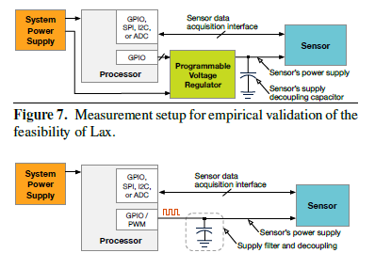
Voltage Scaling
Operation of sensor outside specified supply voltage
Allows varying approximation quality within same system
Notes:
Many sensors can operate outside specified supply voltage
Some sensors may have specifications of undervolted resolutions
•LAX controls the power sent to the sensor via a programmable voltage regulator
The power used may be varied throughout the program if in one read you need a higher accuracy than another
In top figure: Sensor driven/powered by a voltage regulator controlled by the microprocessor
In bottom figure: Sensor driven by a PWM signal from the microprocessor… will work if amount of power the sensor needs is less than the GPIO power output limit

Slide 5
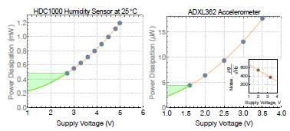
Power savings from voltage scaling
~4x decrease in power dissipation when halving
supply voltage
Notes:
This chart represents a physics based model of how much power sensors use as you decrease their supply voltage
Green region is decreasing supply voltage below manufacturer specs
power dissipation decreases by approximately 4x when halving the supply voltage
Can achieve significant power savings by voltage scaling

Slide 6
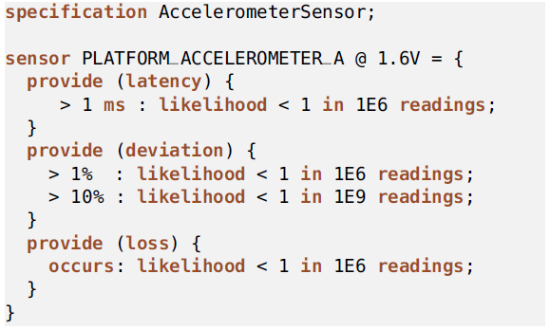
Specification of Sensors
In order to determine the voltage to supply, first, a “Slax specification” is needed.
Voltage supplied
Three characteristics
Level of error
Likelihood of error

Slide 7
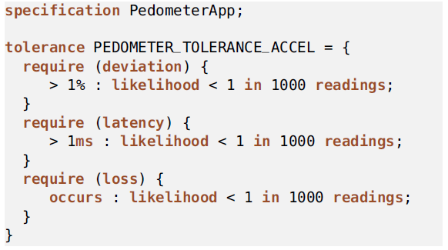
Specification of Tolerances
Next, tolerance levels are needed
Tolerance label
Each type of error
Required likelihoods

Slide 8
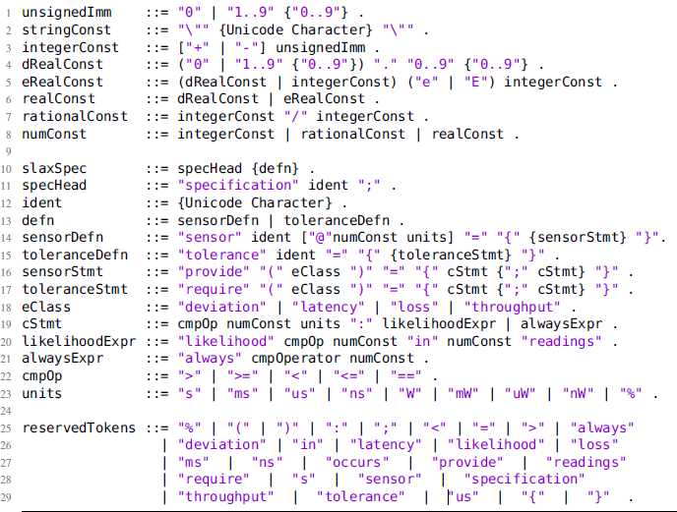
Slax Grammar

Slide 9
Compilation Pipeline
Lax specifications are fed into the Lax Specification Compiler
Lax specification compiler outputs Header and Library
Code makes call to Lax library
Compile and deploy code with any typical tools

Slide 10
Software Library
Lax library sensor reads
Provide sensor and tolerance specification labels
Lax library will use these to determine the appropriate sensor voltage level
No indication as to the accuracy of the read

Slide 11
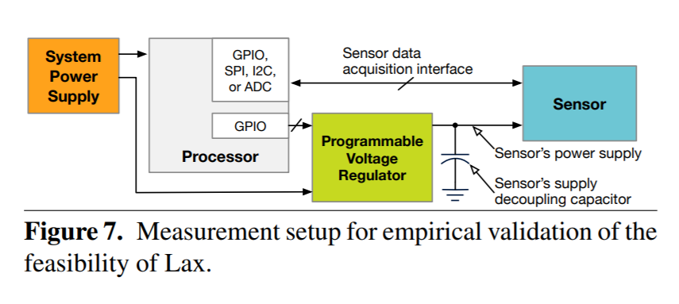
Testing Setup
Used an ARM Cortex-M0+ interfacing with two breakout boards
IR temperature sensor & Gyroscope
Designed a 15 mm² PCB
9 discrete voltage test values between 1.2 and 2.5 V
I2C speed of 1kb/s, not the most intense testing

Slide 12
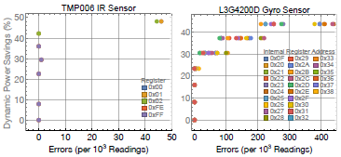
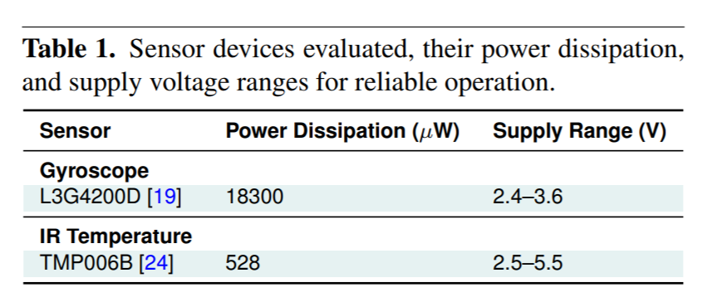
Results
Types of Errors:
Sample Loss / Erasures
Value Deviations
Savings of up to 48% for IR Temp Sensor and 42% for gyroscope
5% max error for IR and 50% for gyroscope
Savings of 16% with no error increase

Slide 13
Challenges / Future Improvements
Obtaining Slax sensor specifications
Requires extensive effort
Obtaining Slax tolerance specifications
Balance between three error tolerances
Dynamic adaption of operating point based on environment
Errors change based on environment

Slide 14
Paper Issues
Mention example testing with accelerometer & humidity but use gyroscope & IR temperature sensor for measurements
Possibly cherry picked data
No Baseline for Value Deviations
Sometimes common sense, sometimes indetectable
Slax specifications appropriately address the different kinds of error you might encounter, however, the testing results provided did not appropriately show these different error types
I2C underclocked 1kbit/s
100kbit/s standard spec

Slide 15
Questions
How are Lax sensor specifications determined? (Choose all that apply)
Lax uses runtime hardware to tune the sensor specifications
Manufacturers provide undervolting characterizations of their sensors
Lax provides a dataflow analysis setup to synthesize the specifications
Users manually test the sensors to determine the error data
How does Lax increase the approximation of the sensors?
Register relaxation
Lower bit truncation
Loop perforation
Supply voltage scaling
When are the Slax Specifications used?
In the loop perforation
When generating the Lax headers and libraries
As an extension to GCC/LLVM/Clang
On the compiled binary before it is flashed to the microcontroller

